Slide 1
Integrative Analysis of Breast Cancer Genomic Data for Personalized Treatment
Presented By: Nabila Noor
Student Number: 501216808

Slide 2

Data Source
The dataset used for this project is called Breast Cancer Gene Expression Profiles (METABRIC) which was initially collected and published by Professor Sam Aparicio of the British Columbia Cancer Centre and Professor Carlos Caldas of the Cambridge Research Institute in Nature Communications.
It includes observations from 1904 patients with breast cancer and has total 695 attributes in three categories:
Clinical Attributes (6 numerical variables)
Genetic Attributes
Mutation

Slide 3
Objective
To predict suitable treatment options for patients.
Prediction of overall survival based on clinical and genetic data
Clustering the genetic data
Survival analysis using Cox proportional hazards regression , Kaplan-Meier survival curves and log rank test based on relevant clinical or genetic criteria.

Slide 4
Methodology
Figure 1: Flow chart for tentative methodology.

Slide 5
Initial Analysis
It includes observations from 1904 patients with breast cancer and has total 695 attributes.
31 clinical attributes, a m-RNA level z-score for 331 genes, and mutation information for 175 genes.
The genetic and mutation data did not have any missing value, however, there were some missing values in the clinical data.
There were no duplicate rows.
There are some outliers for mutation count, tumor size and lymph node examined positive variables for clinical attributes.

Slide 6
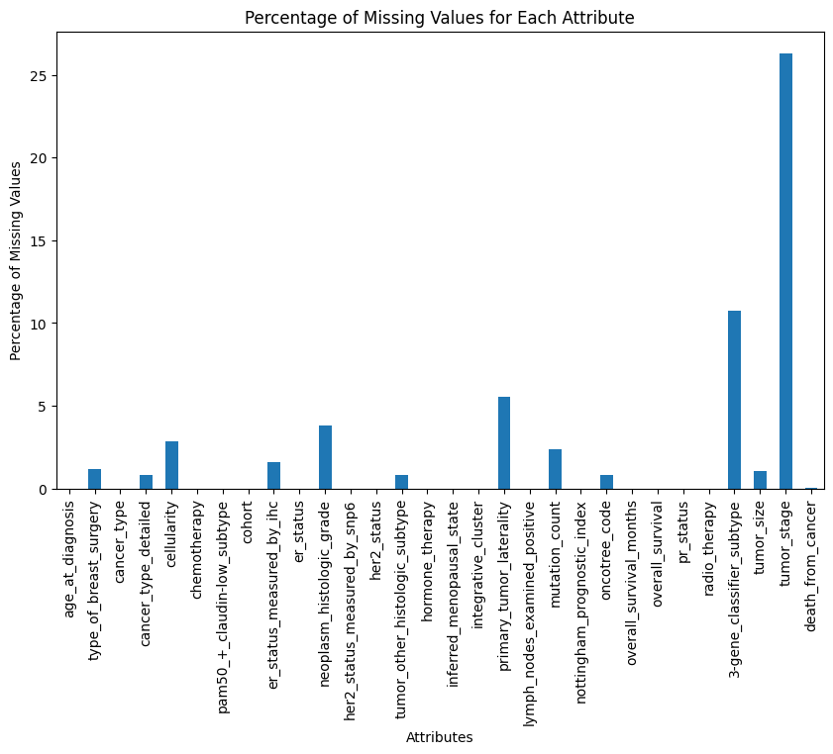
Figure: Percentage of missing values for clinical attributes

Slide 7
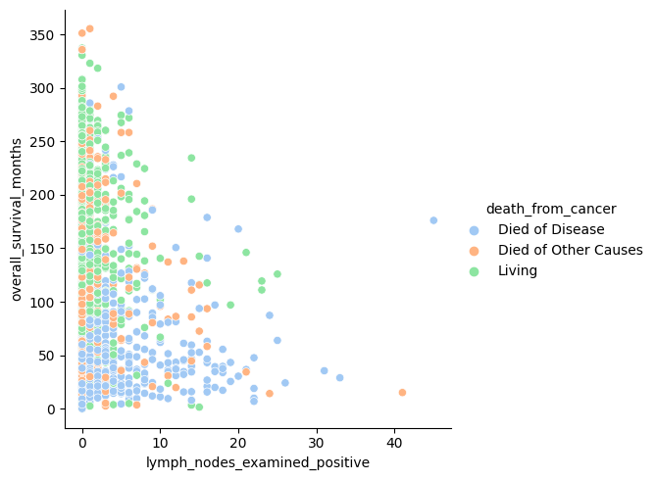
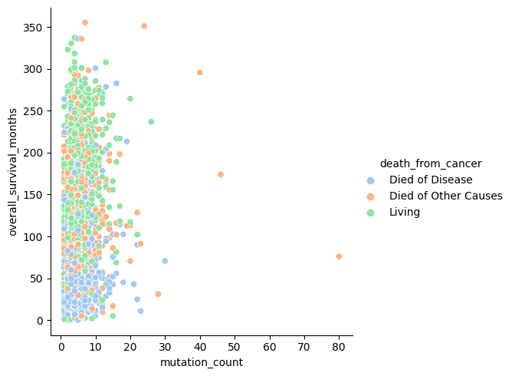
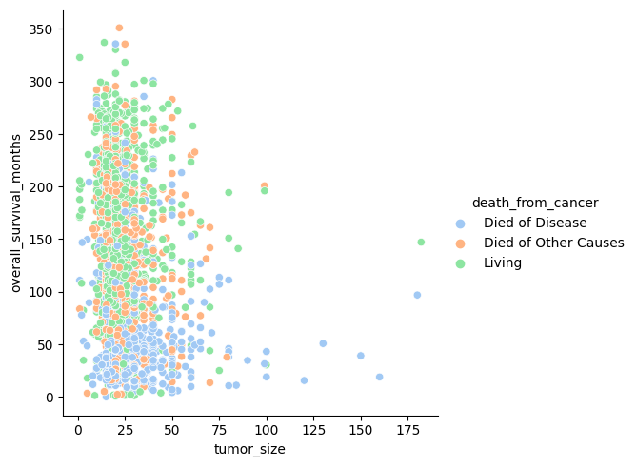

Slide 8
Observations From Initial Analysis:
The mean age of diagnosis is around 61 years with minimum of 21 and maximum of 96 years old
For lymph nodes examined positive, the maximum is 45 and the minimum is 0
Mutation count has a maximum value of 6.3 and a minimum of 1, with a mean of 4.03
Overall survival months have a minimum of 0 months, a maximum of 355.20 months, and a mean survival of 125.121 months.
Tumor size has a maximum of 182, a minimum of 15.16, and a mean of 26.23.

Slide 9
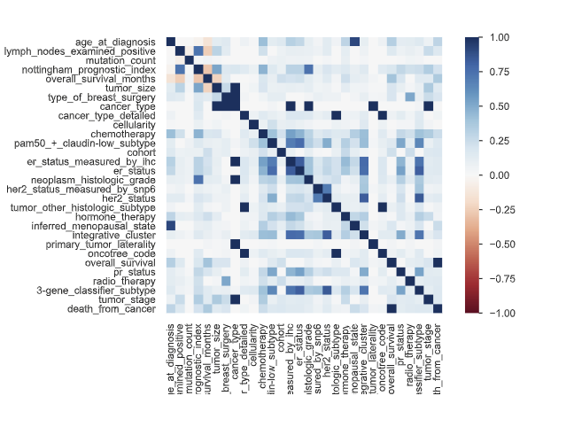

Slide 10
●Type of breast surgery is highly correlated with cancer type. ●Cancer type is highly correlated with tumor size, breast surgery, er status measured by ihc, tumor laterality , histologic subtype and tumor stage. ●Chemotherapy as a treatment is highly correlated with er status measured by ihc. ●Primary tumor laterality is highly overall correlated with cancer type. ●radio_therapy is highly overall correlated with type_of_breast_surgery ●tumor_stage is highly overall correlated with cancer_type

Slide 11
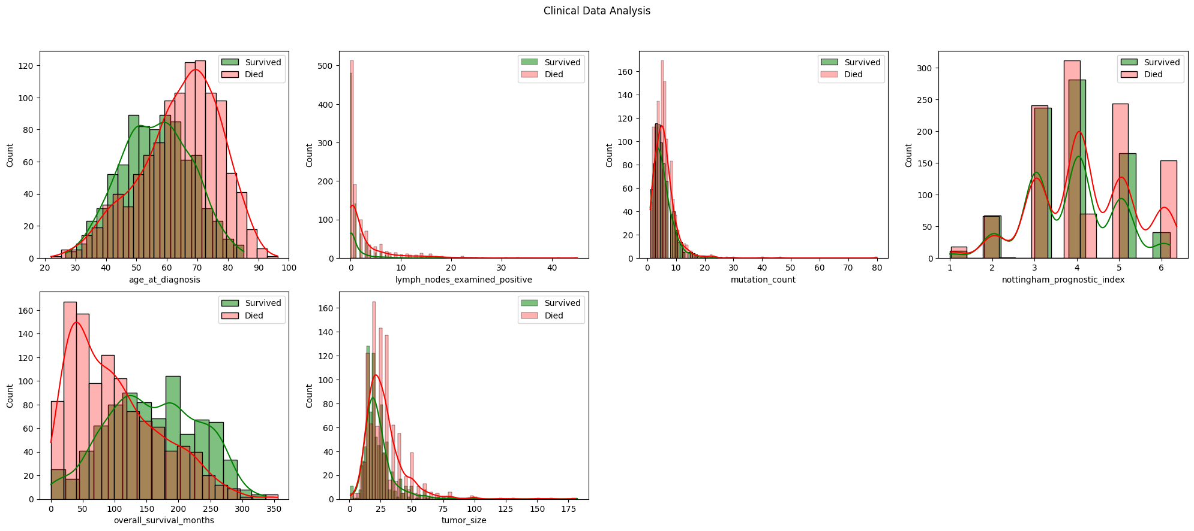
Figure: Distribution of the numerical variables

Slide 12
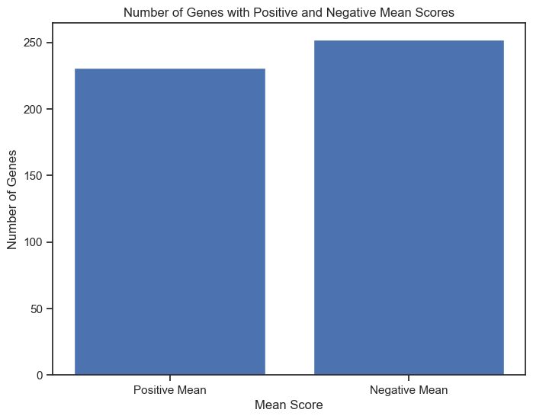
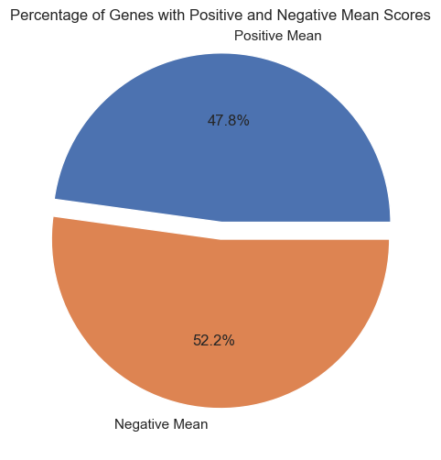
Genes with the lowest mean expression levels: ahnak, cyp17a1, nfkb1, gldc, kmt2d
Genes with the highest mean expression levels: nfkb2, rad51c, pdgfrb, jag1, psen2

Slide 13
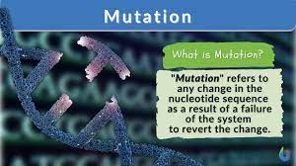
Mutations
The gene with the most unique mutations is tp53 (343), which is a tumor suppressor gene and well associated with cancer prognosis.
Followed by muc16_mut (298), ahnak2_mut (248), kmt2c_mut (222), and syne1_mut (200) .
The mutation data did not have any missing values.

Slide 14
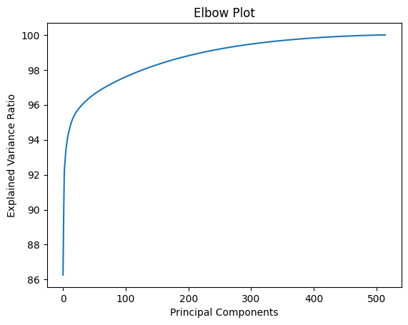
Dimensionality Reduction
For dimensionality reduction Principal Component Analysis (PCA) is used.
Figure : Elbow plot for PCA
Almost 100% of the variance can be explained by first 300 principal components.

Slide 15
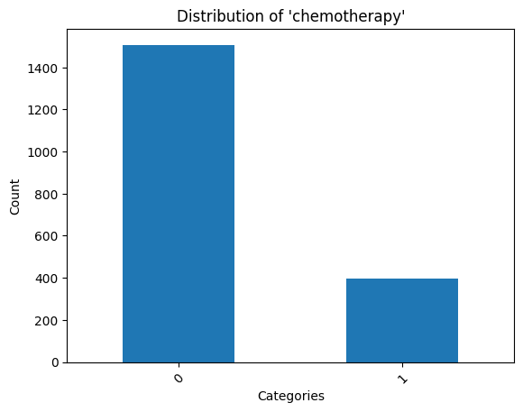
Predicting Treatment (Chemotherapy)
Due to limited scope only, Chemotherapy is predicted as a treatment.
Random Forest, gradient boosting and SVM classifier using 10-fold cross validation used to build the model with first 300 principal components. For training and test data 70/30 ratio was used.
Chemotherapy has imbalanced distribution , resampling algorithm SMOTE (synthetic minority oversampling technique) and ROSE (Random Over-Sampling Examples) are used

Slide 16
Classification results with ROSE
Classification results with SMOTE.
Model Name | Mean Accuracy | Precision | Recall
Random Forest Classifier | 99.5 | 1 | 3.33
Gradient Boosting Classifier | 94.3 | 65.3 | 56.6
SVM Classifier | 94.8 | 75.75 | 62.5
Model Name | Mean Accuracy | Precision | Recall
Random Forest Classifier | 96.6 | 76.1 | 13.3
Gradient Boosting Classifier | 90.8 | 63.8 | 57.5
SVM Classifier | 95.5 | 75.3 | 48.3

Slide 17
Predicting Overall Survival
To predict the overall survival, the same three algorithms are used
Table : Evaluation metrics for overall survival prediction
Model Name | Accuracy | Precision | Recall
Random Forest Classifier | 0.7373 | 0.81627 | 0.6910
Gradient Boosting Classifier | 0.8786 | 0.8844 | 0.8668
SVM Classifier | 0.9873 | 0.9872 | 0.9866
The Random Forest Classifier showed a larger percentage of false negatives (139) compared to the other classifiers, which suggests difficulty in accurately detecting positive cases

Slide 18
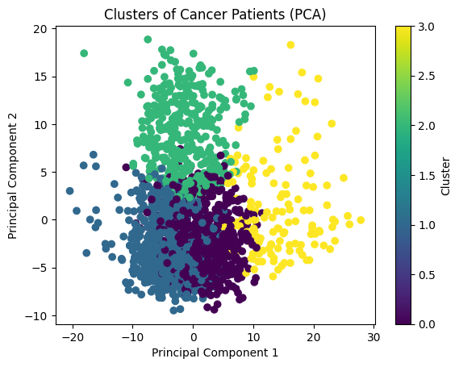
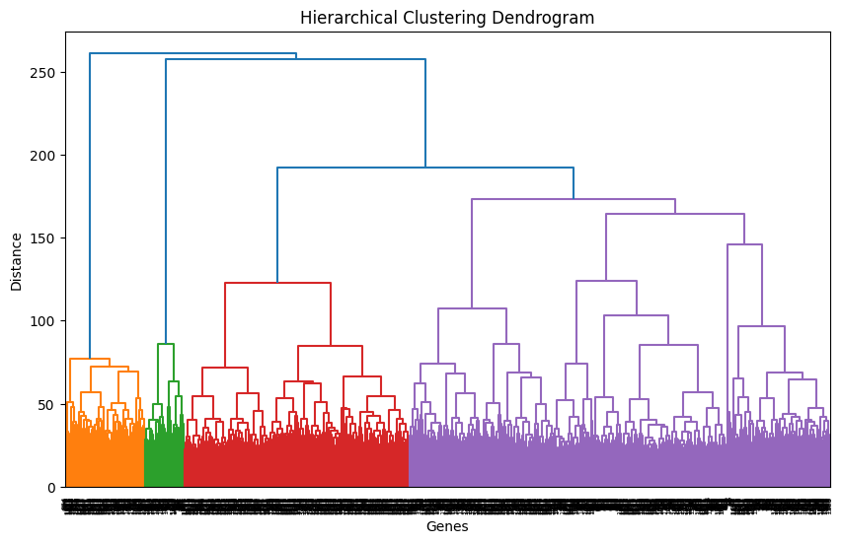
Clustering The Genetic Data
The genetic portion of the data was clustered using k-means clustering algorithm and the adjusted rand index was measured.
With k =4 the adjusted rand index was 0.02. Which indicates the clustering is random in regard to "death_from_cancer"

Slide 19
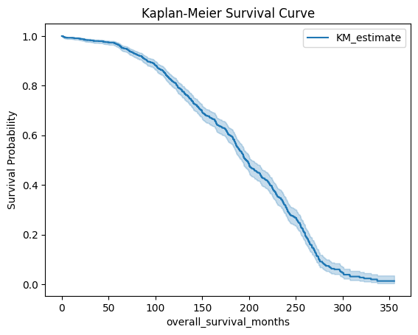
Survival Analysis
The survival function is estimated using the Kaplan-Meier estimator.
At 95% confidence interval the median survival is 199.96 months, with upper limit of 211.77 and lower limit of 193.96 months
.
The narrow range between upper and lower limit represents enough confidence in the results and sufficient patient enrollment in the study
Figure : Kaplan Meier Survival Curve.

Slide 20
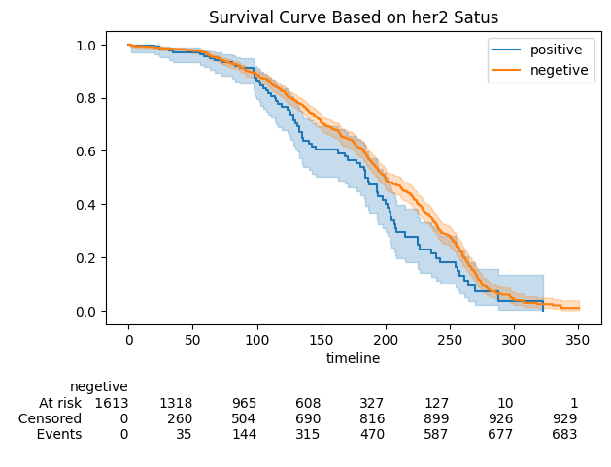
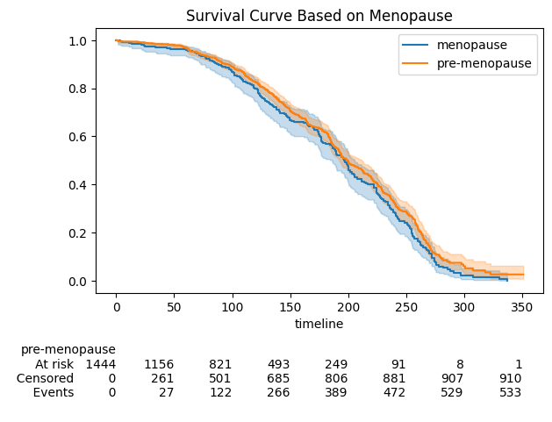

Slide 21
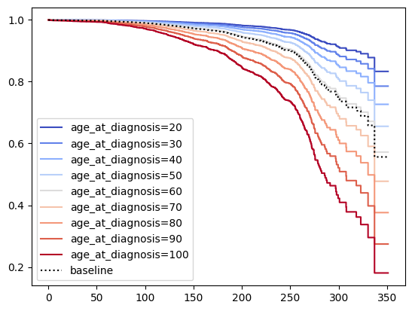
According to the log rank test, there is significant difference in survival between her-2 positive and negative patients.
A cox proportional hazard model was also created, according to the model age at diagnosis, mutation count, tumor stage, chemotherapy and hormonal therapy have significant effect on overall survival and have p values less than 0.05.

Slide 22
Limitations and Future Scope
Prior research on the dataset has mostly concentrated on applying deep learning methods and bioinformatic algorithms. As a result, it might not be possible to compare the project's findings directly to earlier studies.
Inability to directly compare results with earlier research is one of the current work's limitations
Adding new evaluation measures on top of the ones already in place
A larger variety of methods and strategies might also produce more insightful outcome
Concentrating on the most crucial traits and examining how they affect survival might produce perceptive results.

Slide 23
Thank You

